Slide 1
Figures
For Jay

Slide 2
OR-12 Unblocked (3 trials for one experiment + average line on semiology scale) (Units are #/cc and seconds)

Slide 3
Data in Triplicate + Average for Sensor 2

Slide 4
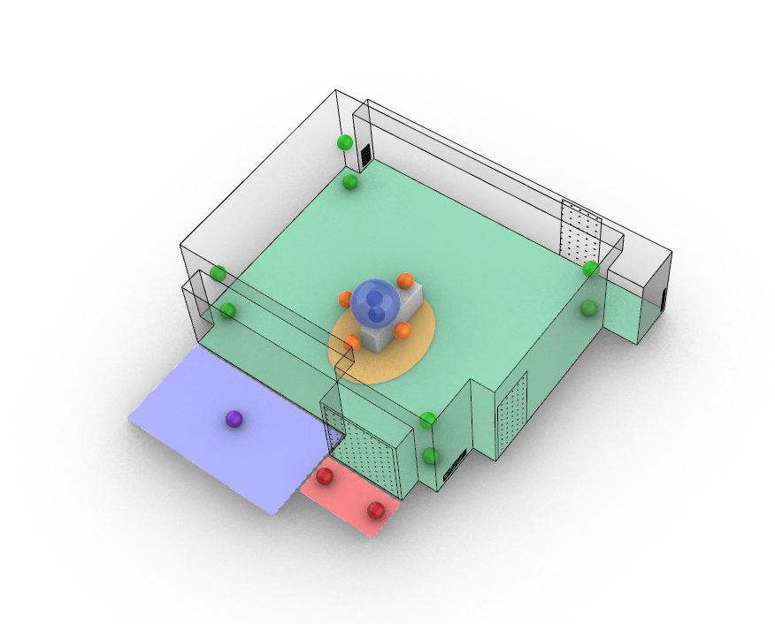
3D Zones
Zone 1
Zone 3
Zone 5
Zone 2
Zone 4

